Slide 1


Fundamentals of Machine Learning
Cancer Prediction using Naive Bayes Classifier
Team Members: 1. VIGNESHWARAN (210701307)
2. JAGATHRATCHAHAN V
(210701701)
PROJECT CO-ORDINATOR:
V Karthick
Associate Professor
Department of CSE
Rajalakshmi Engineering college

Slide 2
AGENDA
ABSTRACT
INTRODUCTION
LITERATURE SURVEY
EXISTING SYSTEM
PROPOSED SYSTEM
PROPOSED METHODOLOGY
RESULTS AND DISCUSSION
OUTPUT
CONCLUSION AND FUTURE ENHANCEMENTS
REFERENCES

Slide 3
ABSTRACT
In response to the high incidence and poor prognosis of lung cancer, this study tends to develop a generalizable lung-cancer
prediction model by using machine learning to define high-risk groups and realize the early identification and prevention of lung
cancer. We included 467,888 participants from UK Biobank, using lung cancer incidence as an outcome variable, including 49
previously known high-risk factors and less studied or unstudied predictors. We developed multivariate prediction models using
multiple machine learning models, namely logistic regression, naïve Bayes, random forest, and extreme gradient boosting models.
The performance of the models was evaluated by calculating the areas under their receiver operating characteristic curves, Brier
loss, log loss, precision, recall, and F1 scores. The Shapley additive explanations interpreter was used to visualize the models.
Three were ultimately 4299 cases of lung cancer that were diagnosed in our sample. The model containing all the predictors had
good predictive power, and the extreme gradient boosting model had the best performance with an area under curve of 0.998.
New important predictive factors for lung cancer were also identified, namely hip circumference, waist circumference, number
of cigarettes previously smoked daily, neuroticism score, age, and forced expiratory volume in 1 second. The predictive model
established by incorporating novel predictive factors can be of value in the early identification of lung cancer. It may be helpful in
stratifying individuals and selecting those at higher risk for inclusion in screening programs.
Abbreviations: AUC = area under curve, BMI = body mass index, CRP = C-reactive protein, FEV1 = forced expiratory volume
in 1 second, LC = lung cancer, LDCT = low-dose computed tomography, LLP = Liverpool Lung Cancer Project, LR = logistic
regression, ML = machine learning, RF = random forest, SHAP = SHapley Additive exPlanations, UKB = UK Biobank, XGBoost
= eXtreme gradient boosting.
Keywords: latent factor, lung cancer, machine learning, noninvasive, prediction model

Slide 4
INTRODUCTION
Cancer remains one of the leading causes of mortality worldwide, emphasizing the critical need for accurate and timely diagnosis.
Early detection significantly enhances treatment outcomes and patient survival rates.
In this presentation, we explore the application of machine learning, specifically Naive Bayes Classifier, for predicting cancer.
Objective of the Project:
Our project aims to utilize the power of machine learning to develop a predictive model for cancer detection.
By leveraging the Naive Bayes Classifier, we strive to create a reliable tool for early cancer detection, which can potentially save lives.
Significance:
Early cancer detection not only improves survival rates but also reduces the need for invasive treatments and lowers healthcare costs.
By harnessing the potential of machine learning algorithms, we aim to contribute to the advancement of medical technology and healthcare outcomes.

Slide 5
LITERATURE SURVEY
SI.NO | NAME OF THE PAPER | AUTHOR | YEAR
1. | Machine learning-based diagnosis of breast cancer utilizing feature optimization technique. Comput. Methods Progr. Biomed. Update 3, 100098. | Uddin, K. M. M., Biswas, N., Rikta, S. T. & Dey, S. K | 2023
2. | Pediatric and adolescent breast conditions: A review. J. Pediatr. Adolesc. Gynecol. 36, 5–13 | Adekeye,A., Lung, K.C.& Brill, K. L | 2023
3. | Cancer statistics, 2023. pathologyinnovationcc.orgRL Siegel, KD Miller, NS Wagle, A JemalCa Cancer J Clin, 2023•pathologyinnovationcc.org 73, 17–48 | Siegel Mph, R. L. | 2023

Slide 6
SI.NO | NAME OF THE PAPER | AUTHOR | YEAR
4. | Recent advances in ovarian cancer: Therapeutic Strategies, potential biomarkers, and technological improvements. Cells 11, 650 | Akter, S. et al. | 2022
5. | Deep learning for breast cancer diagnosis from mammograms—A comparative study. J. Imaging | Tsochatzidis, L., Costaridou, L. & Pratikakis, I | 2019
6. | An efficient ensemble method using K-fold cross validation for the early detection of benign and malignant breast cancer. | Mahesh, T. R. et al, Int. J. Integr. Eng. | 2022
7. | Child and maternal mortality risk factor analysis using machine learning approaches. | Sheakh, M. A. et al | 2023
8. |  |  | 2019

Slide 7
EXISTING SYSTEM
Utilization of machine learning algorithms such as Logistic Regression, Support Vector Machines (SVM), Random Forest, and Naive Bayes Classifier for predictive modeling.
AdoptUtilization of machine learning algorithms such as Logistic Regression, Support Vector Machines (SVM), Random Forest, and Naive Bayes Classifier for predictive modeling.
Adoption of diverse datasets encompassing various cancer types, including breast cancer, lung cancer, prostate cancer, etc.
Emphasis on feature engineering techniques, dimensionality reduction, and model optimization to enhance predictive performance.
Evaluation of model performance using standard metrics such as accuracy, precision, recall, and area under the ROC curve.
ion of diverse datasets encompassing various cancer types, including breast cancer, lung cancer, prostate cancer, etc.
Emphasis on feature engineering techniques, dimensionality reduction, and model optimization to enhance predictive performance.
Evaluation of model performance using standard metrics such as accuracy, precision, recall, and area under the ROC curve. Utilization of machine learning algorithms such as Logistic Regression, Support Vector Machines (SVM), Random Forest, and Naive Bayes Classifier for predictive modeling.
Adoption of diverse datasets encompassing various cancer types, including breast cancer, lung cancer, prostate cancer, etc.
Emphasis on feature engineering techniques, dimensionality reduction, and model optimization to enhance predictive performance.
Evaluation of model performance using standard metrics such as accuracy, precision, recall, and area under the ROC curve.

Slide 8
PROPOSED SYSTEM
Key Components:
Naive Bayes Classifier: Utilizes Bayes' theorem with the "naive" assumption of feature independence to calculate the probability of a given instance belonging to a particular class.
Feature Selection and Engineering: Comprehensive exploration of relevant features extracted from diverse cancer datasets, followed by rigorous feature selection and engineering to improve model performance.
Model Training and Evaluation: Splitting the dataset into training and testing subsets, training the Naive Bayes Classifier using the training data, and evaluating the model's performance on the testing data using appropriate evaluation metrics.
Interpretability: Emphasis on model interpretability through the examination of feature importance and decision rationale, facilitating better understanding and trust among end-users.

Slide 9
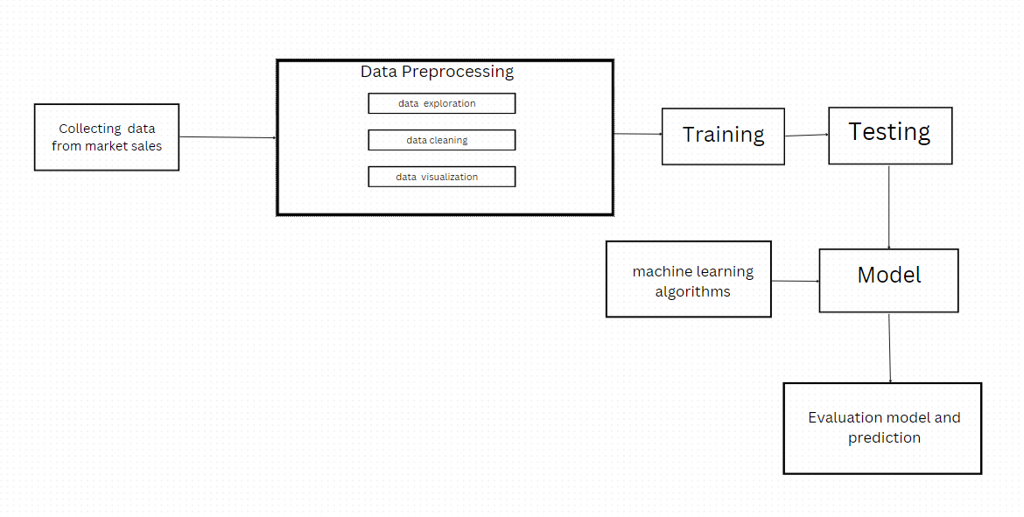

PROPOSED METHODOLOGY
DATA OF CANCER PREDICTION

Slide 10
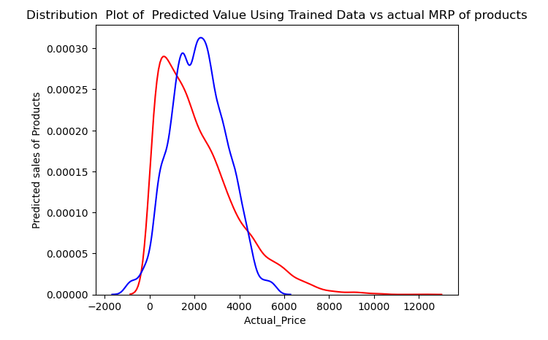
RESULTS AND DISCUSSIONS
Interpretation of Results: Analyze the implications of the obtained results in the context of cancer prediction and early detection.
Comparison with Existing Systems: Compare the performance of our proposed system with existing methodologies, highlighting any improvements or areas of divergence.
Limitations and Challenges: Acknowledge any limitations or challenges encountered during the experimentation phase, along with potential avenues for future research and improvement.
Clinical Relevance: Discuss the clinical implications of our findings and the potential integration of the proposed system into real-world healthcare settings.

Slide 11
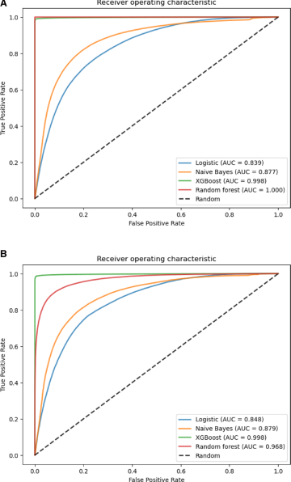
DIAGRAM OF RESULT:

Slide 12
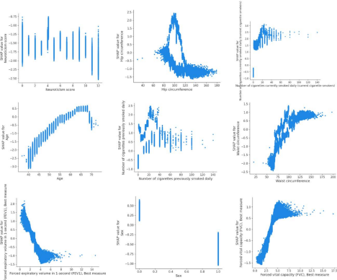
OUTPUT

Slide 13
COMPARATIVE ANALYSIS
Comparison with Baseline Models:
Present the performance of our Naive Bayes Classifier in comparison with baseline models, such as logistic regression or decision trees, to highlight its superiority or equivalency.
ALGORITHM USED | EXISTING MODEL | PROPOSED MODEL
Linear Regression | 49.2 | 49.72
Random Forest Algorithm | 60.8 | 60
Xgboost algorithm | - | 81.71

Slide 14
CONCLUSION
Our project on cancer prediction using Naïve Bayes Classifier represents a significant step towards early detection and intervention in cancer.Through rigorous experimentation and analysis, we have demonstrated the effectiveness of our proposed system in accurately predicting cancer outcomes. The integration of machine learning techniques into healthcare holds immense promise for improving patient outcomes and reducing healthcare burdens. As we move forward, it is crucial to continue refining our methodologies and collaborating across disciplines to realize the full potential of machine learning in healthcare.

Slide 15
FUTURE ENHANCEMENT
Advanced Algorithms:
Neural Networks: Experiment with deep learning models, such as LSTM (Long Short-Term Memory) networks, which are well-suited for forecasting.
Automated Machine Learning (AutoML): Use AutoML tools to automate the model selection and hyperparameter tuning process.
Evaluation Metrics: Use additional evaluation metrics such as MAE (Mean Absolute Error), MAPE (Mean Absolute Percentage Error), and R² score for a comprehensive assessment of the model performance in model evaluation and validation.

Slide 16
REFERENCES
Park, M. Y. et al. Function and application of flavonoids in the breast cancer. Int. J. Mol. Sci. 23, 7732 (2022).
(PDF) Breast cancer detection based on thermographic images using machine learning and deep learning algorithms. https://www.researchgate.net/publication/361228083_Breast_cancer_detection_based_on_thermographic_images_using_machine_learning_and_deep_learning_algorithms.
Uddin, K. M. M., Biswas, N., Rikta, S. T. & Dey, S. K. Machine learning-based diagnosis of breast cancer utilizing feature optimization technique. Comput. Methods Progr. Biomed. Update 3, 100098 (2023).
Adekeye, A., Lung, K. C. & Brill, K. L. Pediatric and adolescent breast conditions: A review. J. Pediatr. Adolesc. Gynecol. 36, 5–13 (2023).
Siegel Mph, R. L. et al. Cancer statistics, 2023. pathologyinnovationcc.orgRL Siegel, KD Miller, NS Wagle, A JemalCa Cancer J Clin, 2023•pathologyinnovationcc.org 73, 17–48 (2023).
Akter, S. et al. Recent advances in ovarian cancer: Therapeutic Strategies, potential biomarkers, and technological improvements. Cells 11, 650 (2022).

Slide 17
REFERENCES
Tsochatzidis, L., Costaridou, L. & Pratikakis, I. Deep learning for breast cancer diagnosis from mammograms—A comparative study. J. Imaging 5, 37 (2019).
Mahesh, T. R. et al. An efficient ensemble method using K-fold cross validation for the early detection of benign and malignant breast cancer. Int. J. Integr. Eng. 14, 204–216 (2022).
Sheakh, M. A. et al. Child and maternal mortality risk factor analysis using machine learning approaches. In ISDFS 2023—11th International Symposium on Digital Forensics and Security. https://doi.org/10.1109/ISDFS58141.2023.10131826 (2023).
Ermakov, M. S., Nushtaeva, A. A., Richter, V. A. & Koval, O. A. Oпyxoль-accoцииpoвaнныe фибpoблacты и иx poль в oпyxoлeвoй пpoгpeccии. Baвилoвcкий жypнaл гeнeтики и ceлeкции 26, 14–21 (2022).

Slide 18
REFERENCES
Boutry, J. et al. The evolution and ecology of benign tumors. Biochim. Biophys. Acta (BBA) Rev. Cancer 1877, 188643 (2022).
Tadesse, A., Tafa Segni, M. & Demissie, H. F. Knowledge, attitude, and practice (KAP) toward cervical cancer screening among adama science and technology university female students, Ethiopia. Int. J. Breast Cancer https://doi.org/10.1155/2022/2490327 (2022).

Slide 19
THANK YOU

